Slide 1
Rotate Performance under Three status ( LatestHPX )
Three status:
Original rotate:
Add split_core function (partition)
Remove unneed asynchronous
NOTE:
1. git log:
commit 4b087d4341b65e4ae8c5fa636a3978c8f45aaa1c (HEAD -> master, origin/master, origin/HEAD)
2.

Slide 2
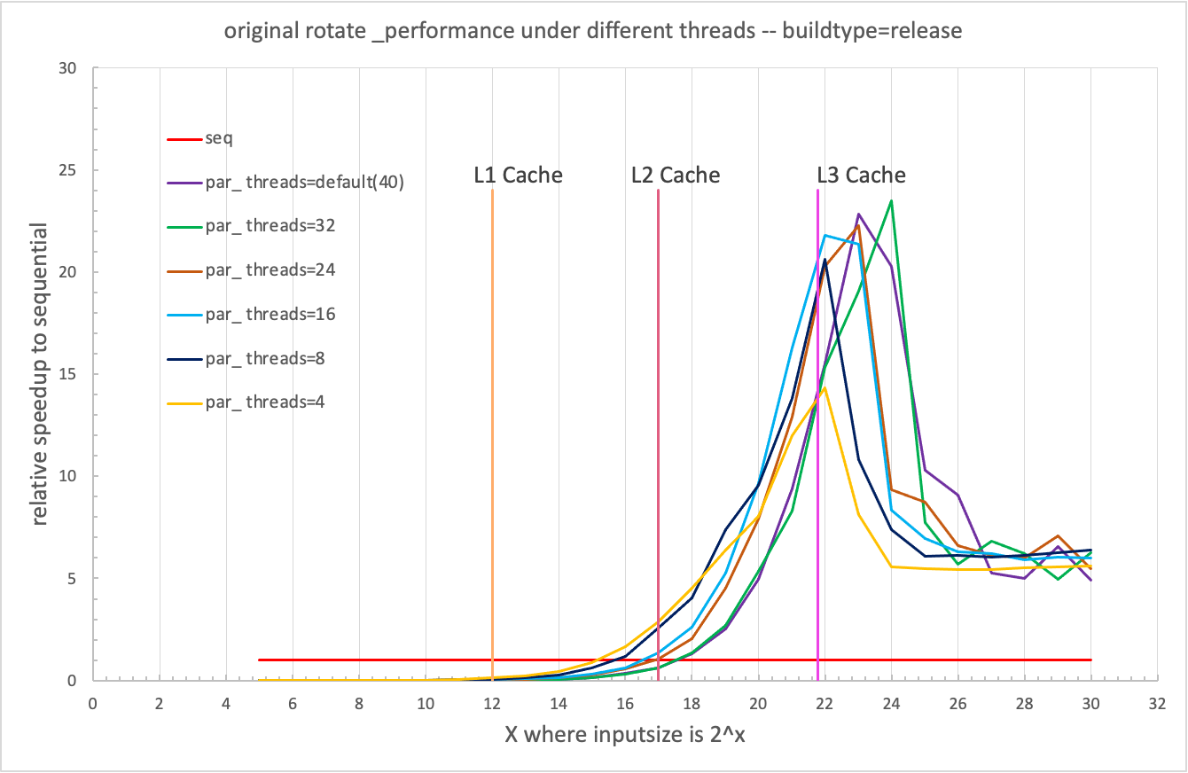

Slide 3
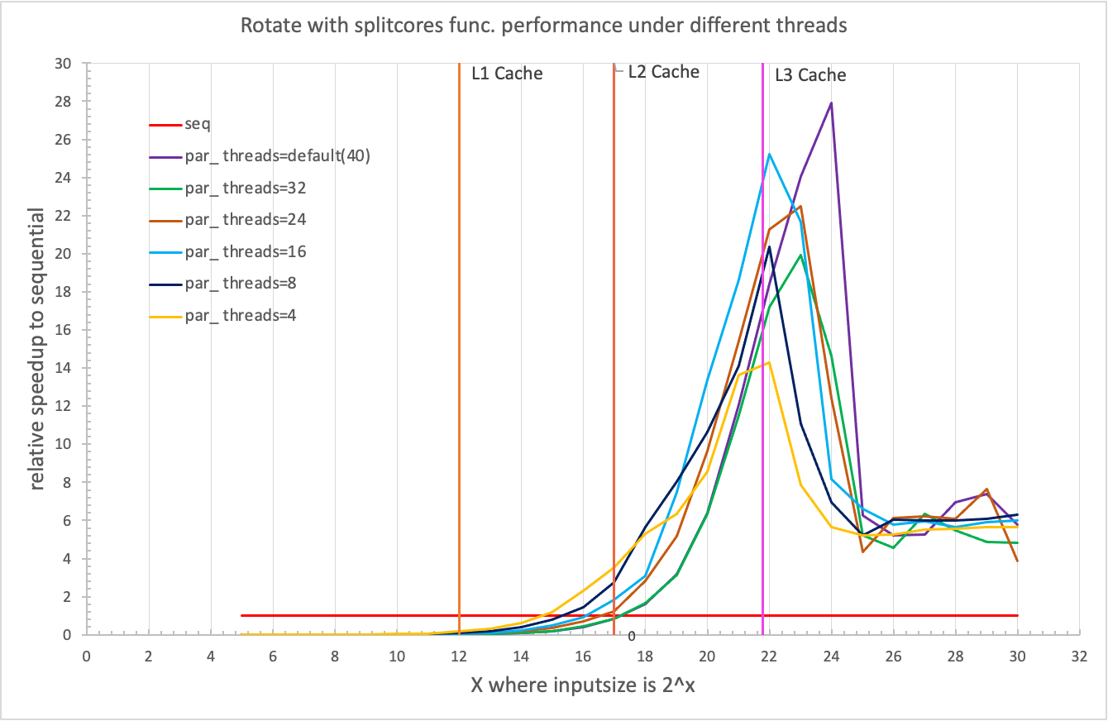

Slide 4
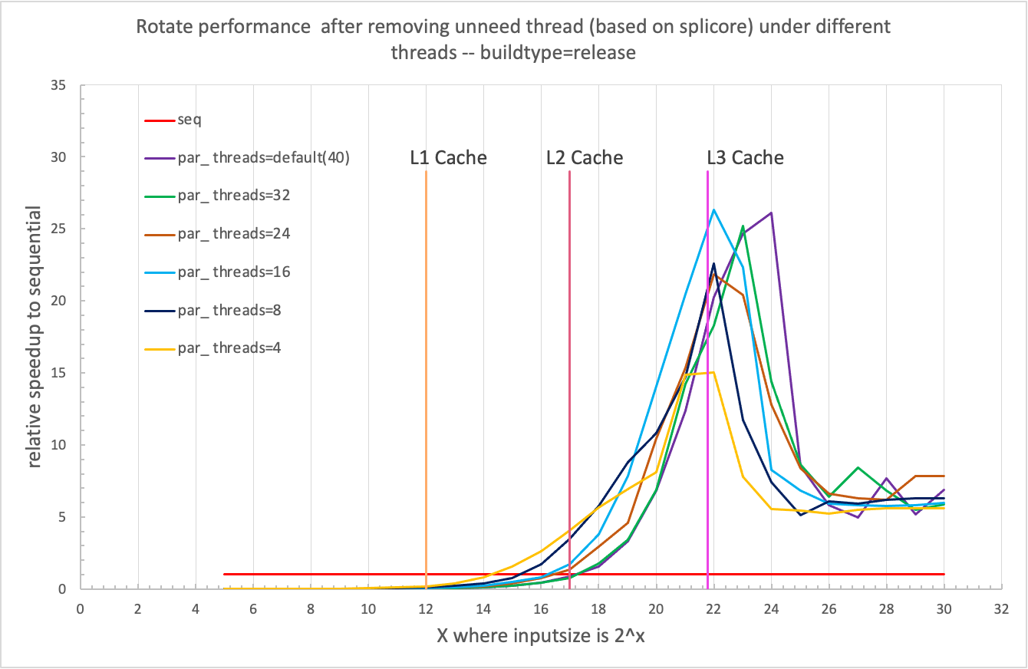

Slide 5
Compare three status under same cores
327: new adding 327 correct test results of the third step(remove unneeded thread). figure with 327 on top_right.

Slide 12
SUM:
rotate performance got improved after adding partition func. and removing unneed asynchronous thread.
Remaining issue: the improvement under core 4 (8,16) is unreasonable, its too much, but have no idea what’s going on there. Need further exploration.

